Slide 1

Project Title - Netflix Dataset Analysis
Vedant Kolsure
STU68622f4541e721751265093

Slide 2

PROBLEM STATEMENT
The rapid growth of OTT platforms has intensified competition for Netflix, with major rivals like Amazon Prime, Disney+, and various regional streaming services entering the market.
To maintain its leadership position, Netflix must strategically evaluate its content catalog to identify strengths, gaps, and new opportunities for growth. “How has Netflix’s content distribution (Movies vs. TV Shows, genres, and country contributions) evolved over the years, and what insights can be derived to guide future content acquisition and production strategies?” This problem requires analyzing the dataset to uncover:
The balance between Movies and TV Shows in Netflix’s library.
The most common genres and how their popularity has changed over time.

Slide 3
Project Description The project titled “Content Trends Analysis for Strategic Recommendations – Netflix Dataset” focuses on exploring and analyzing Netflix’s extensive content library to uncover meaningful patterns and insights. As one of the largest global streaming platforms, Netflix continuously expands its catalog through a combination of original productions and licensed titles. However, with the rising competition from platforms like Amazon Prime, Disney+, and various regional OTT providers, it has become increasingly important for Netflix to adopt a data-driven approach to strengthen its content strategy and maintain market leadership. This project utilizes a Netflix dataset (in CSV format) that includes detailed information about movies and TV shows, such as release dates, genres, categories, countries of origin, and other relevant attributes. By applying data analytics and visualization techniques, the project aims to derive insights into the distribution of Movies vs. TV Shows over the years, the popularity and evolution of genres, and the country-wise contribution to Netflix’s global catalog. Through this analysis, the project identifies key trends, strengths, gaps, and opportunities within Netflix’s library. These insights enable Netflix to refine its content acquisition and production strategies, ensuring that it appeals to diverse audiences around the world while maintaining a competitive edge in the streaming industry. The analysis is conducted using Python, Pandas, Matplotlib, and Seaborn within a Jupyter Notebook environment, with the potential to extend the results into interactive dashboards using Tableau or Power BI for enhanced visualization and decision-making. Ultimately, this project provides strategic recommendations to guide Netflix’s future direction in content investment, global market expansion, and audience engagement.

Slide 4

WHO ARE THE END USERS?
Netflix Management & Strategy Teams
To make data-driven decisions regarding content acquisition, production, and licensing.
Helps identify trending genres, popular countries, and underrepresented markets for strategic planning.
Content Acquisition & Production Teams
To determine which movies or TV shows to invest in.
Supports decisions on regional content focus, such as K-dramas, Spanish thrillers, or Indian productions.
Marketing Teams
To design targeted campaigns based on audience preferences by genre and region.
Example: Promoting Indian movies in Asian markets or K-dramas to global youth audiences.
Data Analysts & Researchers
To analyze trends in OTT platforms.
Provides insights for academic studies, business research, or market analysis.
Assists investors and business partners in understanding growth potential and aligning with Netflix’s strategy.
Competitor Platforms (Amazon Prime, Disney+, etc.) – Indirect End Users
Can benchmark Netflix’s content strategy to adjust and optimize their own content catalogs.

Slide 5

Technology Used
1. Data Handling & Preprocessing
Python – Primary language for data analysis.
Pandas – For cleaning, transforming, and manipulating datasets.
NumPy – For numerical operations and handling large arrays efficiently.
2. Data Visualization
Matplotlib – For basic plots such as line charts, bar charts, and scatter plots.
Seaborn – For advanced statistical visualizations like heatmaps and distribution plots.
3. Exploratory Data Analysis (EDA)
Jupyter Notebook / Google Colab – For interactive coding, analysis, and visualization.
Excel – For quick data checks, summaries, and initial exploration.

Slide 6
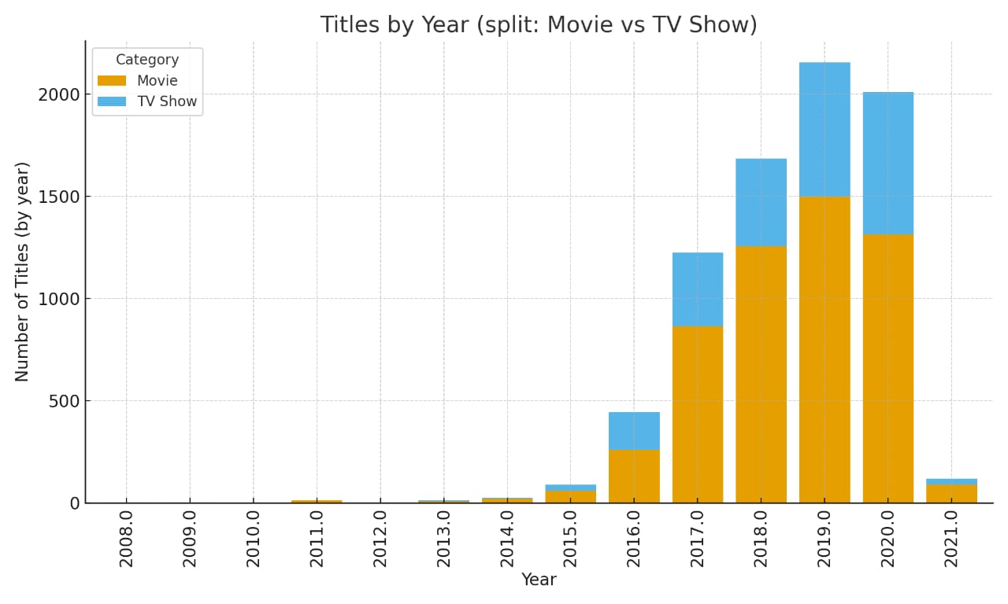
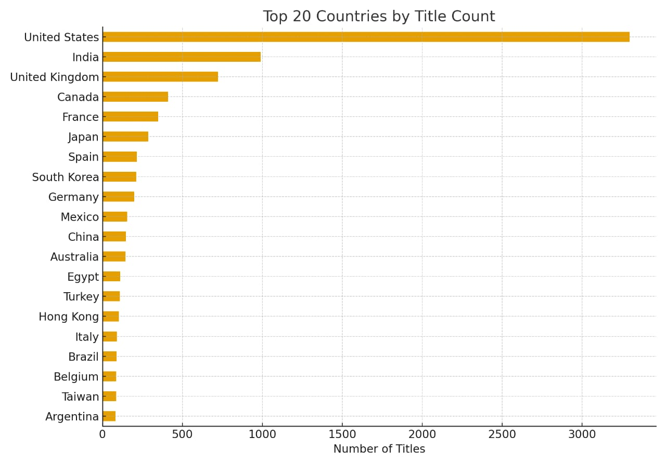
RESULTS1
[Add screen shots of your code or Chart(s) ]

Slide 7
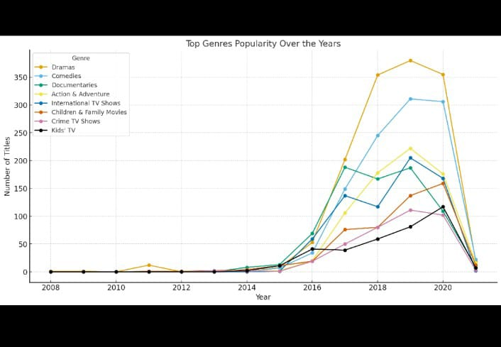
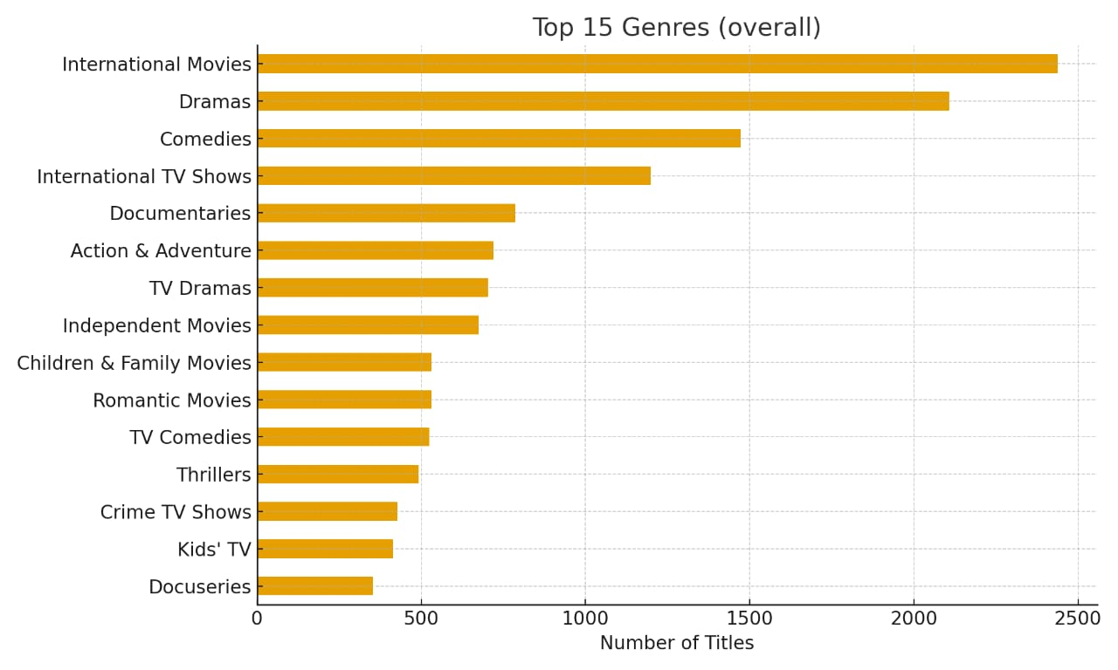
RESULTS2
[Add screen shots of your code or Chart(s) ]

Slide 8
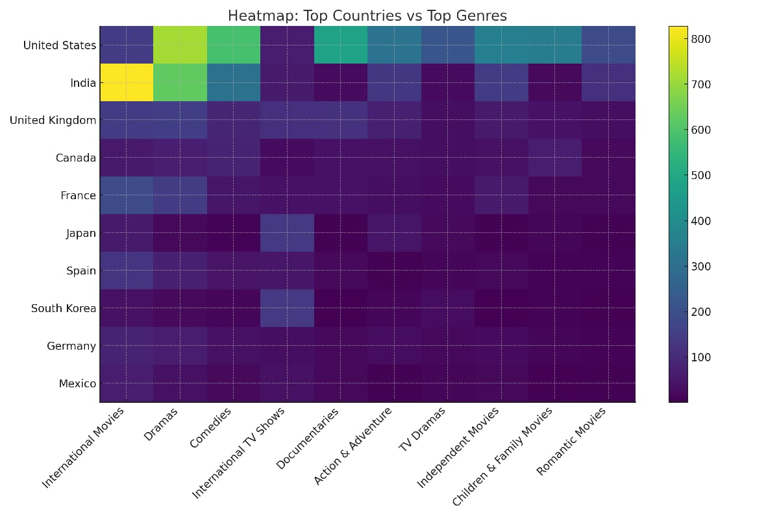
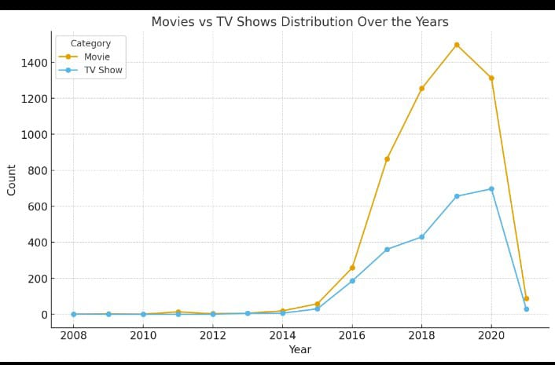
RESULTS3
[Add screen shots of your code or Chart(s) ]

Slide 9
GitHub repository
https://github.com/Vedant-K007/-VOIS_AICTE_Oct2025_MajorProjectNetflix_VEDANT-KOLSURE.git

Slide 10

Getting started with Basics of Python Certificate
[Paste your Certificate Here]

Slide 11
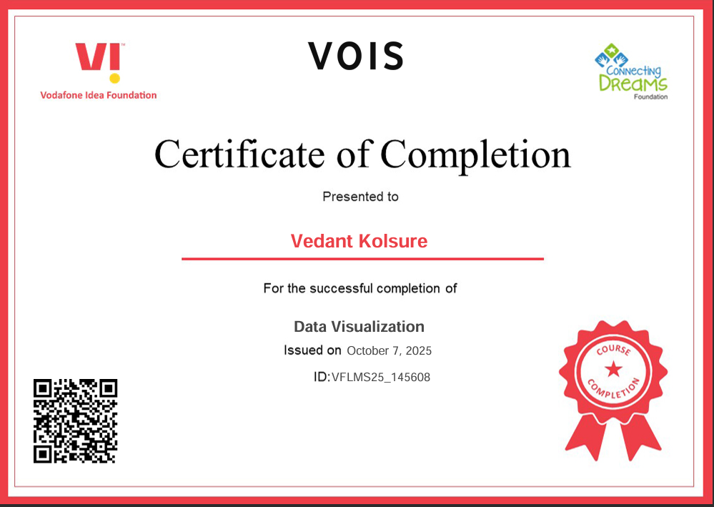
Data Visualization Certificate
[Paste your Certificate Here]

Slide 12
Thank you
.
.

